Slide 1
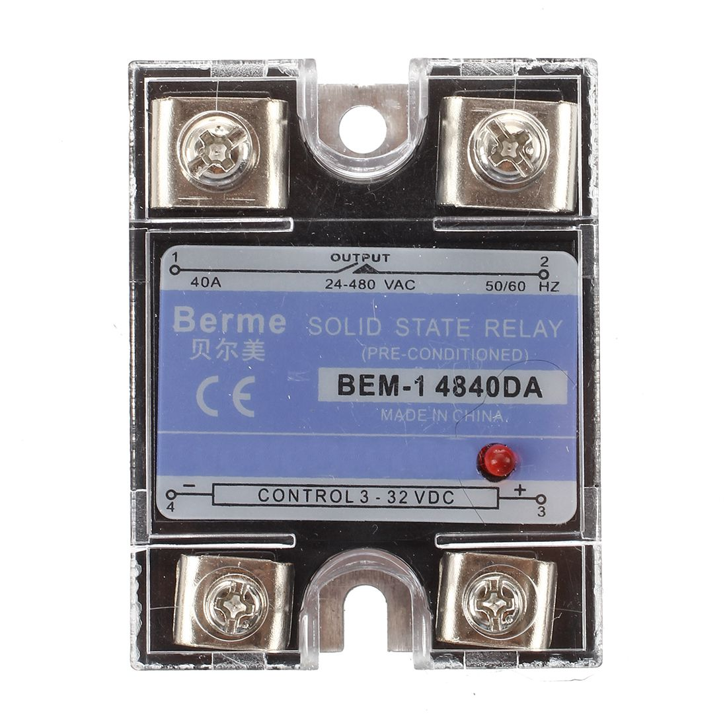
Input Circuit:
Control circuit
Provides loop for input control signal
Receives signals from microcontroller
Drive Circuit:
Isolated from input, converts control signal into trigger signal
LED
Output Circuit:
- Receive trigger signal from driver to control ON/OFF

Slide 3
H1
H2
H3
H4
C1
C2
C3
C4
Relay | Arduino Pin | Wire Color
H1 | 22 | orange
C1 | 23 | yellow
H2 | 24 | green
C2 | 25 | blue
H3 | 26 | brown
C3 | 27 | white
H4 | 28 | red
C4 | 29 | purple/black

Slide 4
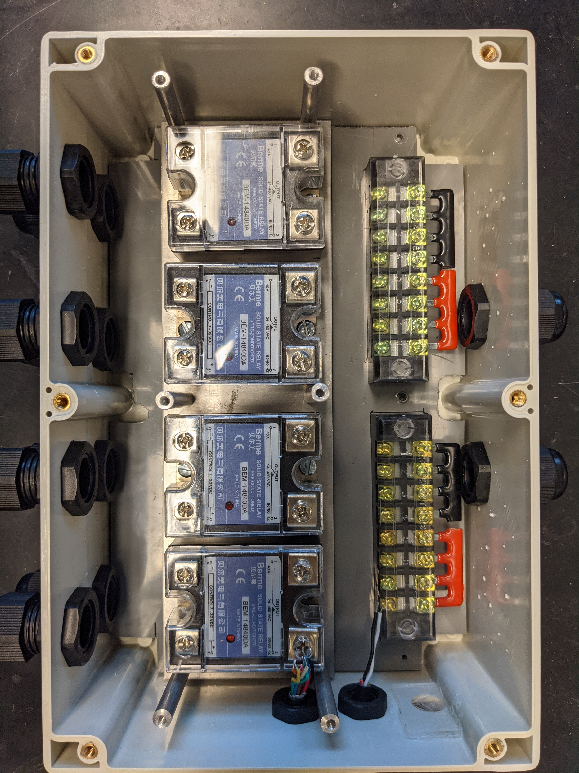






















Slide 5









3
4
3
4
2
1
2
1

Slide 6








3
4
3
4
2
1
2
1

Slide 7









3
4
3
4
2
1
2
1

Slide 8






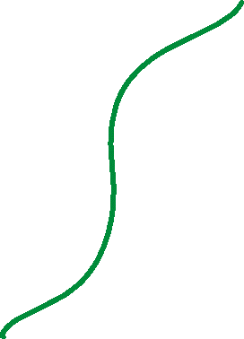

1
2
1
2
4
3
4
3

Slide 9





1
2
1
2
4
3
4
3

Slide 10


















- 1
+ 2
- 1
+ 2
- 4
+ 3
- 4
+ 3

Slide 11
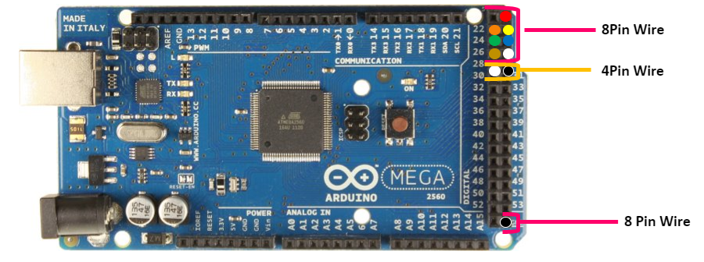
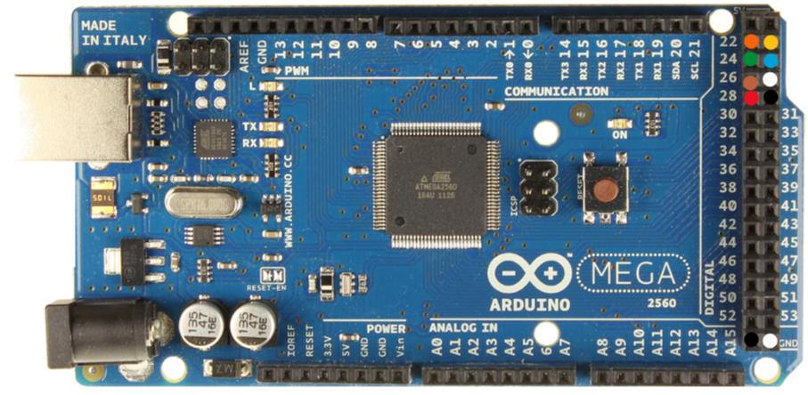
8 Pin
4 Pin

